Slide 1
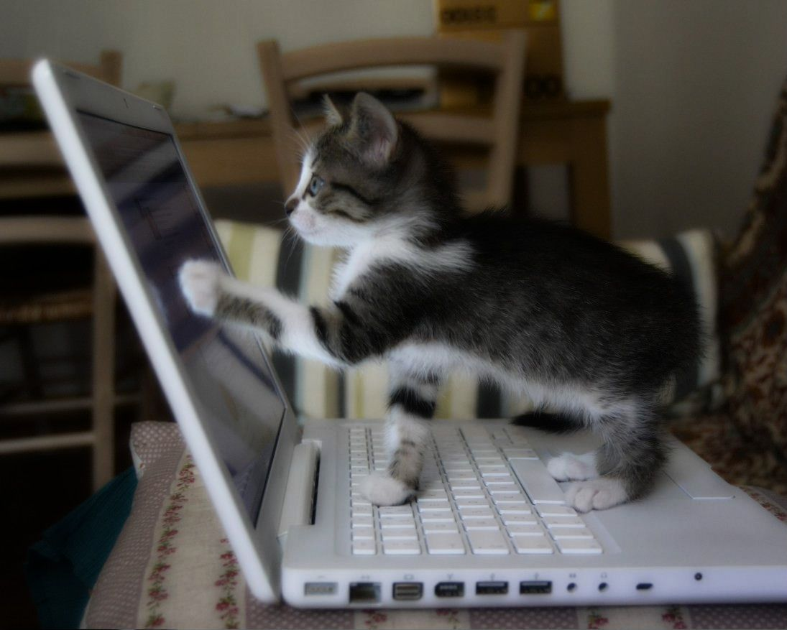
Understanding Users CSCI 5839 Fall 2014 – Shaun Kane
Notes:
http://cdn.attackofthecute.com/December-22-2011-23-48-46-amelieandthemacbookbyameliecatd4didn6.jpeg

Slide 2
Feedback from class survey
+ Fun, interactive
+ No textbook, no exams!
– Seats uncomfortable
– Hard to see
– Scheduling assignments at strange times
Notes:
But give feedback later too

Slide 3
Seats
Thursday: Everyone gets a new seat!
Sit near project groups
But feel free to move now :)

Slide 4
Scheduling
Reading comments always due midnight before class
Other assignments will keep to Tuesdays/Thursday (lead time when needed)

Slide 5
Group assignment process
Everyone’s project preference forms in now
We will make preliminary assignments tomorrow

Slide 6
Inspirations

Slide 7
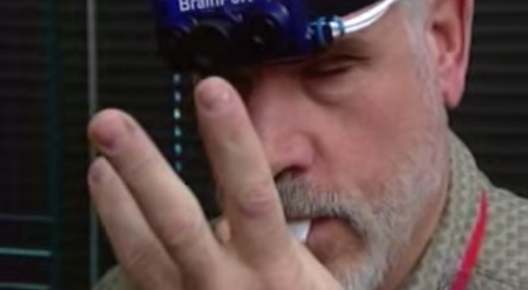
Blind Sensory Substitution (via Jake)

Slide 8
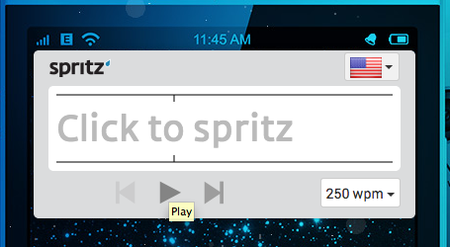
Spritz (via Zhihao) aka RSVP

Slide 9
Comments on reading
Designing for radically different types of people (e.g. blind)
‘Ugh, this model of people is gross and reductionist. In it, humans aren't humans. They are are "information processing systems" with "input-output channels" and "processing capabilities." It seems like the authors are designing for life inside the Matrix.’

Slide 10
Today
Understanding humans
Cognition
Perception
Motor ability
Putting it all together
Understanding your users
Who are your users?

Slide 11
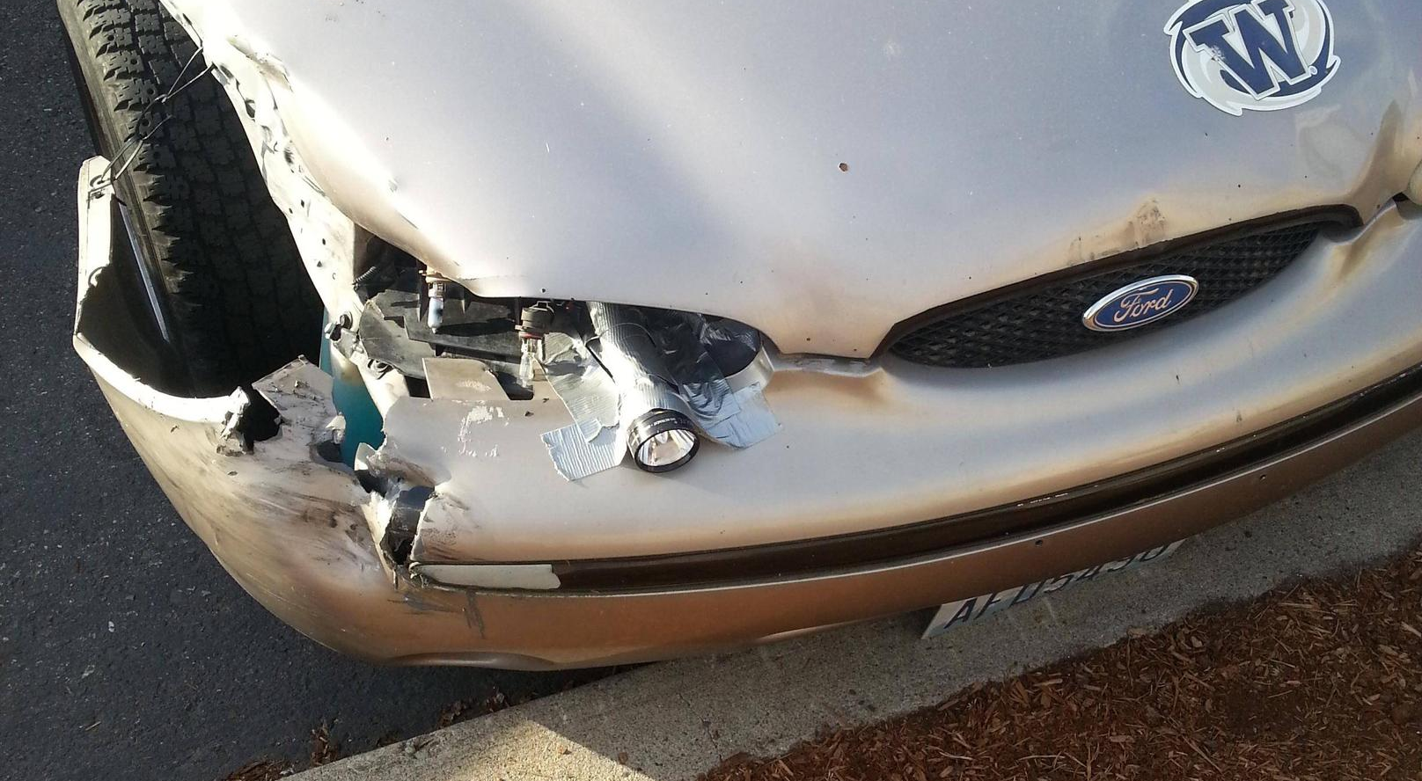
Humans are interesting
Notes:
Reddit.com/r/thereifixedit

Slide 12
Aspects of cognition
Memory
Short term (working) vs. long term
Chunking
Cognition
Problem solving
Declarative vs. procedural knowledge

Slide 13
Aspects of perception
Visual perception
Auditory perception
Tactile/haptic perception
Notes:
Tactile: touch; haptic:force

Slide 14
Visual perception oddities
Reading order
Preattentive perception

Slide 15
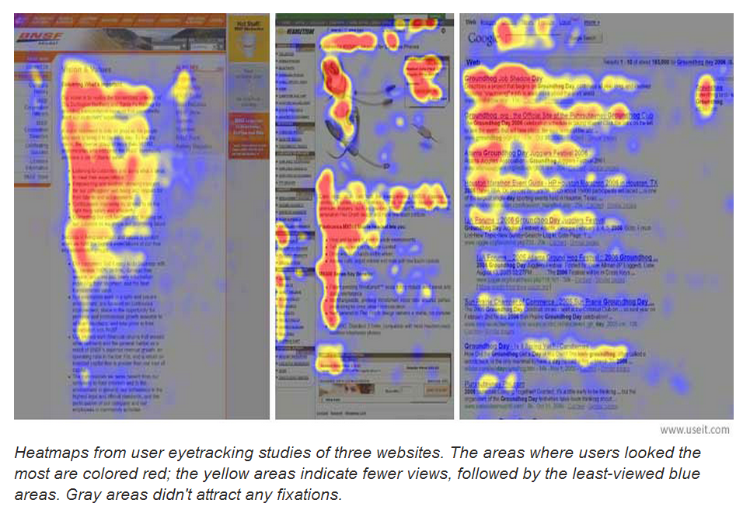

Slide 16

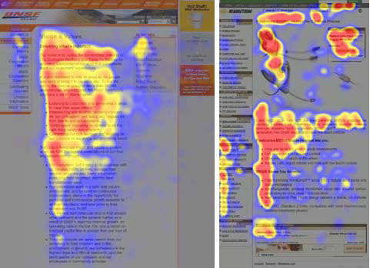
Taking advantage of the F pattern
Notes:
http://blog.crazyegg.com/2012/11/08/lessons-eye-tracking-studies/

Slide 19
Let’s try again.

Slide 22
Pre-attentive Processing
a limited set of visual properties that are detected very rapidly and accurately by the low-level visual system
[Christopher Healey, http://www.csc.ncsu.edu/faculty/healey/PP/]
Notes:
Typically, tasks that can be performed on large multi-element displays in less than 200 to 250 milliseconds (msec) are considered preattentive.
Eye movements take at least 200 msec to initiate, and random locations of the elements in the display ensure that attention cannot be prefocused on any particular location, yet viewers report that these tasks can be completed with very little effort.
This suggests that certain information in the display is processed in parallel by the low-level visual system.

Slide 23

Actually, not really preattentive… these visual properties were initially called preattentive, since their detection seemed to precede focused attention. We now know that attention plays a critical role in what we see, even at this early stage of vision. The term preattentive continues to be used, however, since it conveys an intuitive notion of the speed and ease with which these properties are identified.
Professor Christopher G. Healey
North Carolina State University
http://www.csc.ncsu.edu/faculty/healey/

Slide 24
Where do we see this in the wild?

Slide 25
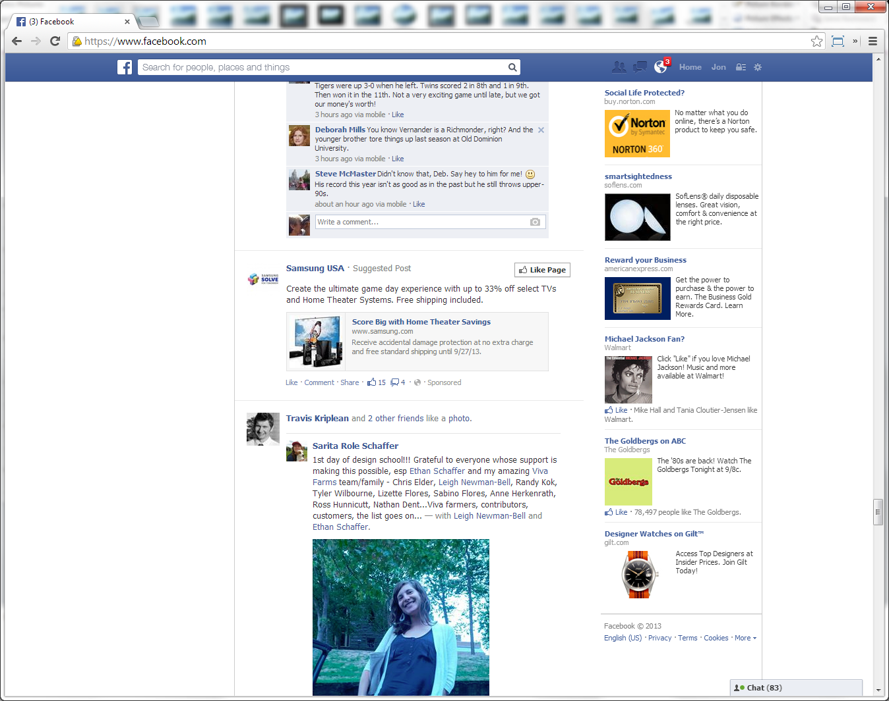

Slide 26
Hue is not the only visual feature that is preattentive.

Slide 28
Notes:
As before, a viewer can rapidly and accurately determine whether the target is present or absent. Here, the visual system identifies the target through a difference in curvature (or form).

Slide 29
Find the red ball…

Slide 31
Why didn’t this work?
A conjuction target is a target made up of a combination of non-unique features and typically cannot be detected preattentively.
[Christopher Healey, http://www.csc.ncsu.edu/faculty/healey/PP/]

Slide 32
Numerous studies have shown that this target cannot be detected preattentively. Instead, viewers must perform a time-consuming serial search to confirm the presence or absence of the red circle.
Notes:
A target made up of a combination of non-unique features (a conjunction target) normally cannot be detected preattentively. Fig. 3 shows an example of conjunction search. The red circle target is made up of two features: red and circular. One of these features is present in each of the distractor objects (red squares and blue circles). This means the visual system has no unique visual property to search for when trying to locate the target.

Slide 33
Aspects of perception
Visual perception
Auditory perception
Tactile/haptic perception
Smell
Taste
Notes:
Tactile: touch; haptic:force

Slide 34

How computers have traditionally seen us
O’Sullivan and Igoe, Physical Computing, 2004, p. xix

Slide 35
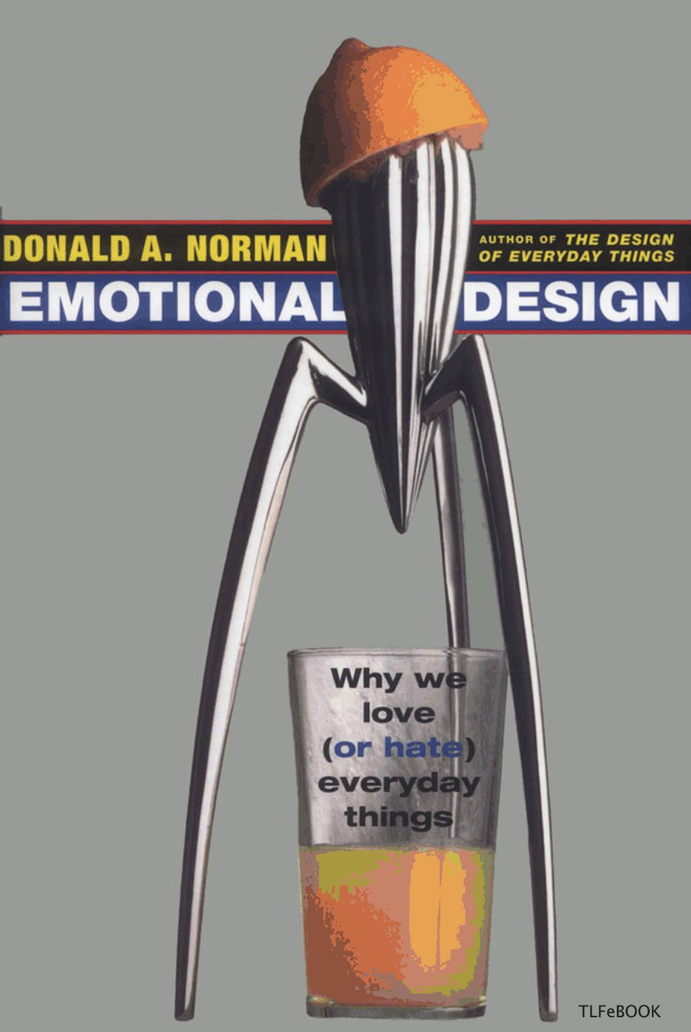
Other aspects of performance
Emotion
Attention
Output!
Speech
Touch
Movement

Slide 36


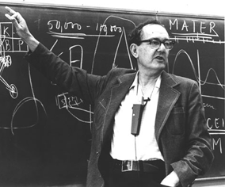

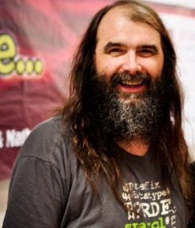

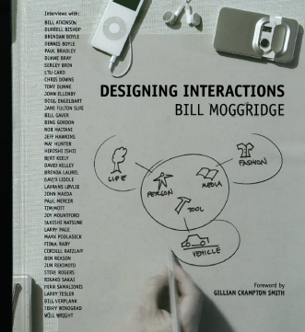
“
What information consumes is rather obvious: it consumes the attention of its recipients. Hence a wealth of information creates a poverty of attention, and a need to allocate that attention efficiently among the overabundance of information sources that might consume it.
”
Herbert Simon
Professor Carnegie Mellon University
Nobel Prize / Turing Award Winner
From: Designing Organizations for an Information-Rich World, 1971, p. 40-41
Notes:
Simon, H. A. (1971), "Designing Organizations for an Information-Rich World", in Martin Greenberger, Computers, Communication, and the Public Interest, Baltimore, MD: The Johns Hopkins Press, ISBN 0-8018-1135-X

Slide 37

Awareness Test
Simons & Chabris, 1999
Source: http://youtu.be/Ahg6qcgoay4
Notes:
http://www.youtube.com/watch?v=Ahg6qcgoay4

Slide 38
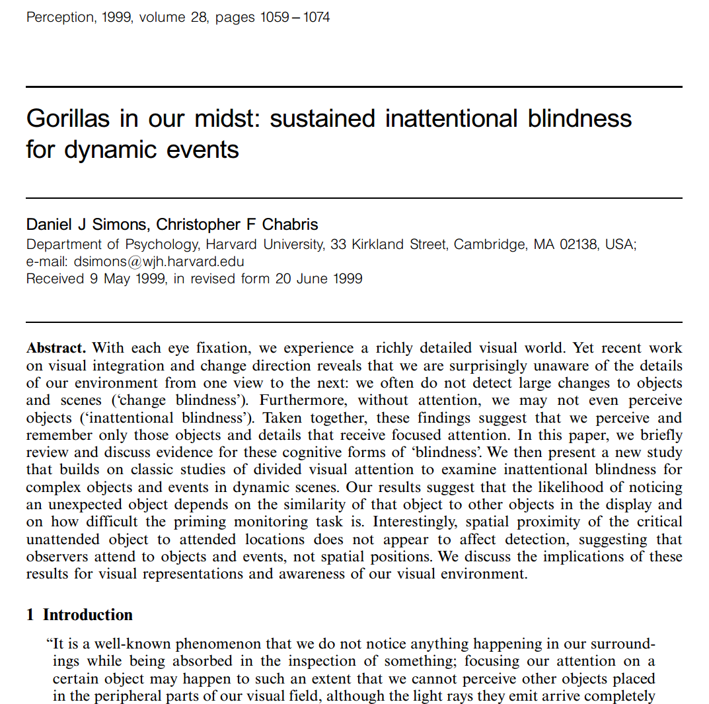

Slide 39
To summarize (leaving many interesting things out)
We satisfice (Simon 1956)
We are cognitive misers (Fiske and Taylor 1991)
However, our brain is optimized for certain activities and information
Notes:
Satisfy + suffice

Slide 40
Putting it all together
We can model human problem solving
Card, Moran, and Newell (1983): Model Human Processor

Slide 41
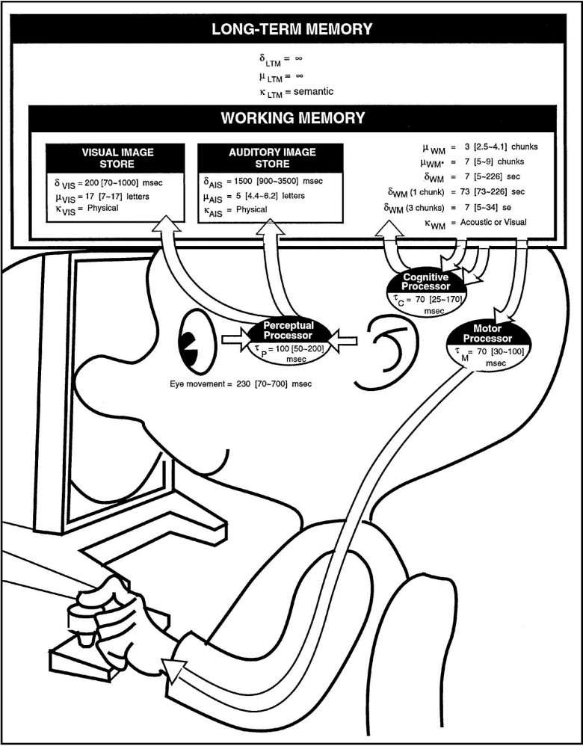
Model Human Processor
The Model Human Processor offers a simplified view of the human processing involved in interacting with computing systems.
Comprises three subsystems:
Perceptual system
Motor system
Cognitive systems
Card, Moran, and Newell, The Psychology of Human-Computer Interaction, p. 26
Notes:
Card, Moran, and Newell, The Psychology of Human-Computer Interaction, p. 26

Slide 42
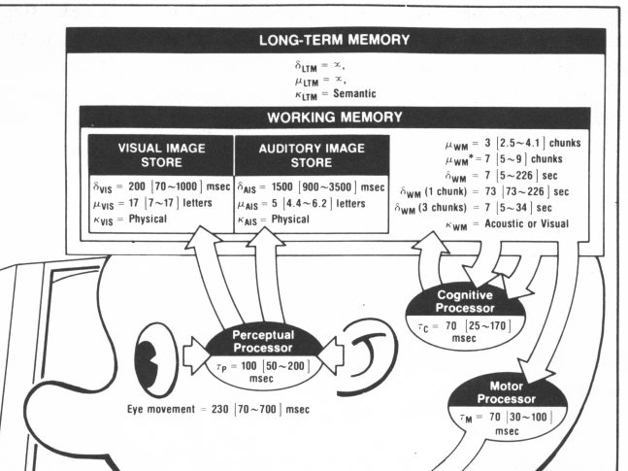

Slide 43
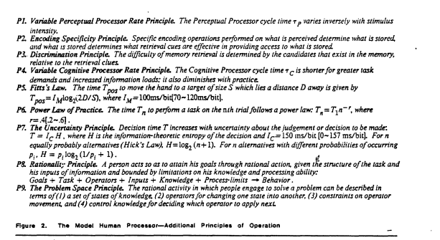

Slide 44
Model Human Processor
We can assign times to the operations of the MHP
And use it to predict performance

Slide 45
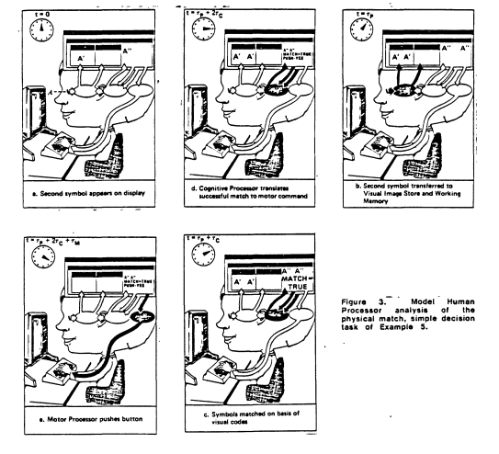

Slide 46
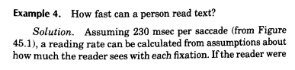
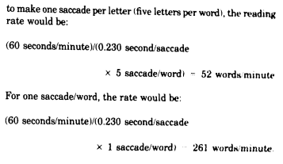
(Card, Moran and Newell 1983)

Slide 47
Other cognitive models
GOMS (Card, Moran, and Newell, 1983)
Keystroke-level model (Kieras, 1993)

Slide 48
Keystroke level model (Kieras 1993)

Slide 49
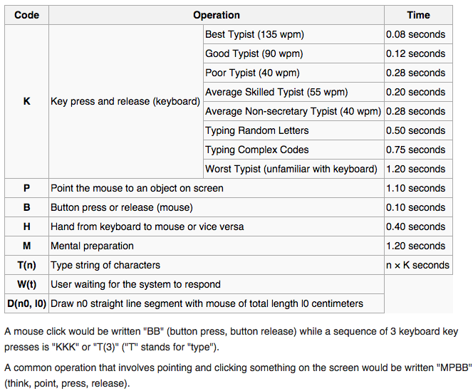
Notes:
http://en.wikipedia.org/wiki/Keystroke-level_model

Slide 50
Thoughts on cognitive models

Slide 51
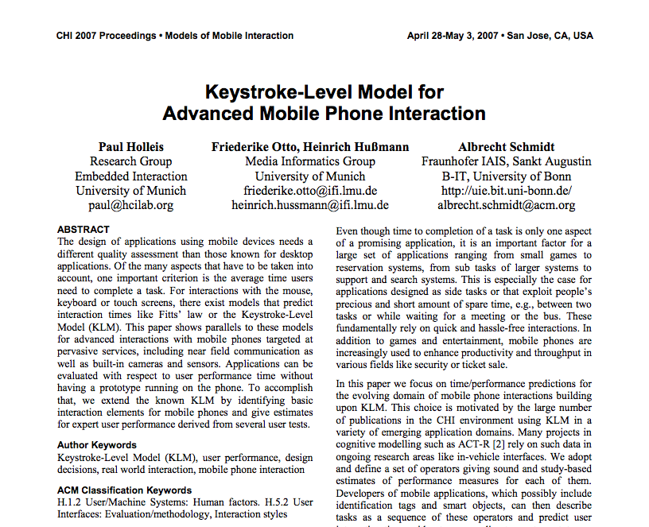

Slide 52
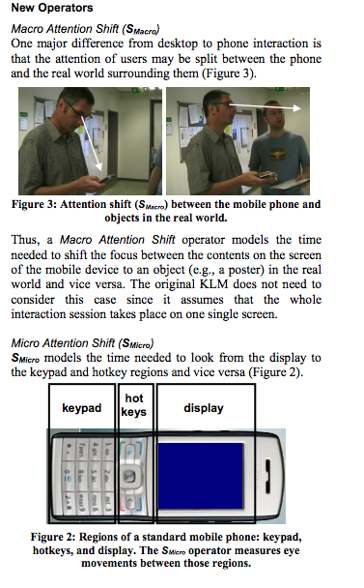
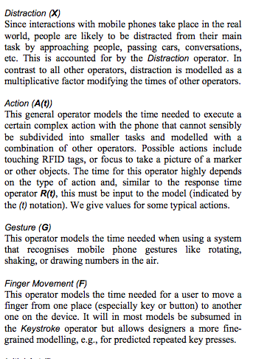

Slide 53
Who are your users?
Understanding demographics of our users
Identifying specific representative users
Personas (in a few weeks)
Notes:
Demographic: people writing

Slide 54

Designing a new wearable device
What do we want to know about our users?
Notes:
Age, gender, handedness,
Image: https://twitter.com/rstevens/status/509410771319934976

Slide 55
A brief list of user characteristics
Age
Gender
Culture
Language
Ability
Education (reading level)
Experience
Notes:
Additional: vision abilities, motor abilities, past experiences, language,

Slide 56
How do these affect design?
Age => reading, physical ability level, HOW BIG TO MAKE THE TEXT
Gender =>
Culture =>
Language => language order
Ability =>
Education =>
Experience => fear of technology
Notes:
Additional: vision abilities, motor abilities, past experiences, language,

Slide 57
Knowledge
About technology
About the domain

Slide 58
What else we need to know?
Environment – in what environment does the task take place?
Task – what are the tasks? what steps are required to complete each task?

Slide 59
Environmental analysis
What factors should we consider about the user’s environment?
Urban, rural
Loud
Movement/shock
Weather: sunlight, temperature

Slide 60
Factor
Effect on design
Notes:
What device, environment, people around, movement

Slide 61
Task analysis
What common tasks will a user perform?
How are they currently practiced?

Slide 62
Hierarchical task analysis (HTA)
Decompose activity into hierarchical steps
Create a hierarchy of tasks
Create a plan for navigating that task

Slide 63
HTA practice
How do we make a cup of tea?

Slide 64
Make tea
Obtain of pen
Boil water
Put water into pan
Apply heat
Put the pan on the stove
Turn on a stove
Obtain tea
Wait
Obtain cup
…
Drink tea

Slide 65
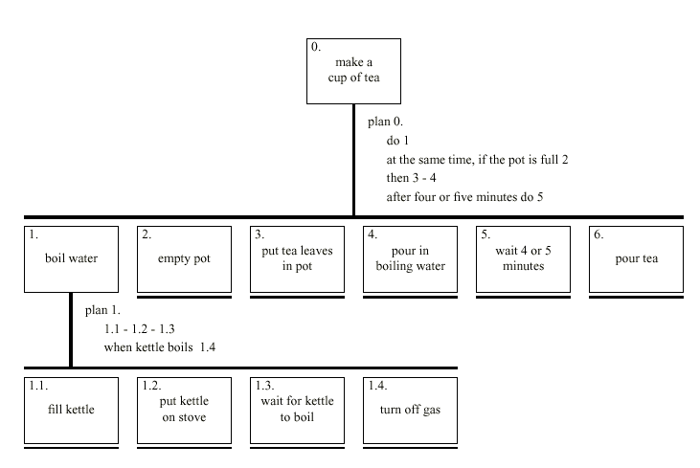

Slide 66
But is this good enough?
Now that we have our first HTA, we ask “What have we missed or gotten wrong?”
Ask experts to look at our HTA, but do they have expert blindspots?
We can examine subtasks and think about them in context of whole system.
1.4 says turn off gas, but did we ever turn it on?

Slide 67
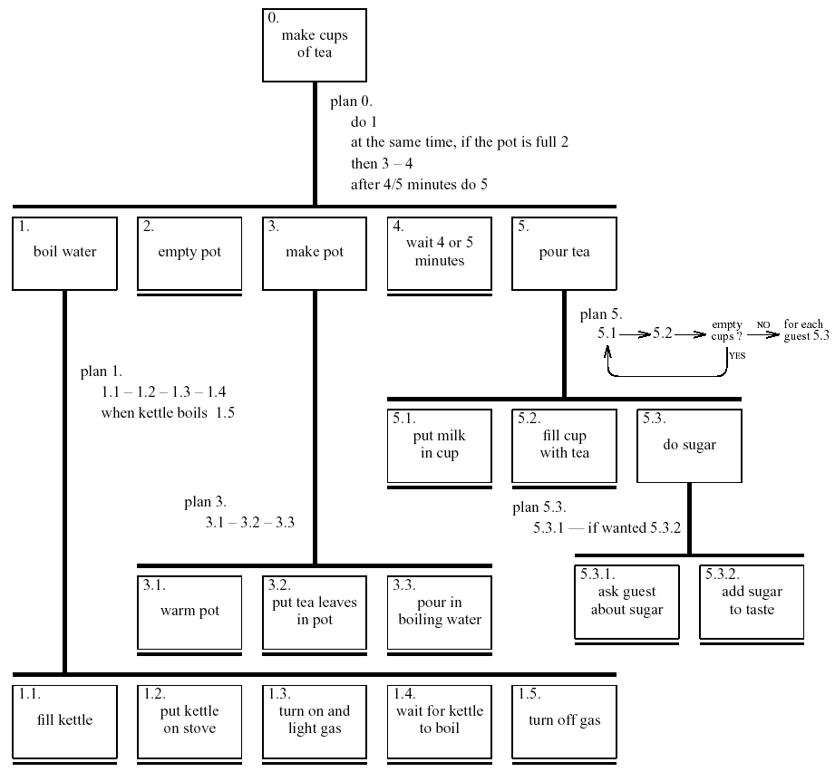

Slide 68
What can we get from task analysis?
Notes:
Understand how users see the world
Identify problems and fix them (without disrupting workflow)

Slide 69
Practice
Let’s brainstorm users, environment, tasks
Users: List variables to describe your users (and answers)
Environment: List use environments (and design considerations)
Tasks: List common tasks

Slide 70
Due before next class
Reading (how to give a killer presentation)
Project pitches
Preliminary assignments tomorrow
Any concerns, contact us ASAP

